Slide 1
Design by Contract
Dirk Riehle, FAU Erlangen
ADAP B04
Licensed under CC BY 4.0 International

Slide 2
Agenda
Design by contract
Expressing contracts
Implementing contracts
Contract violations
Contract pragmatics
Homework

Slide 3
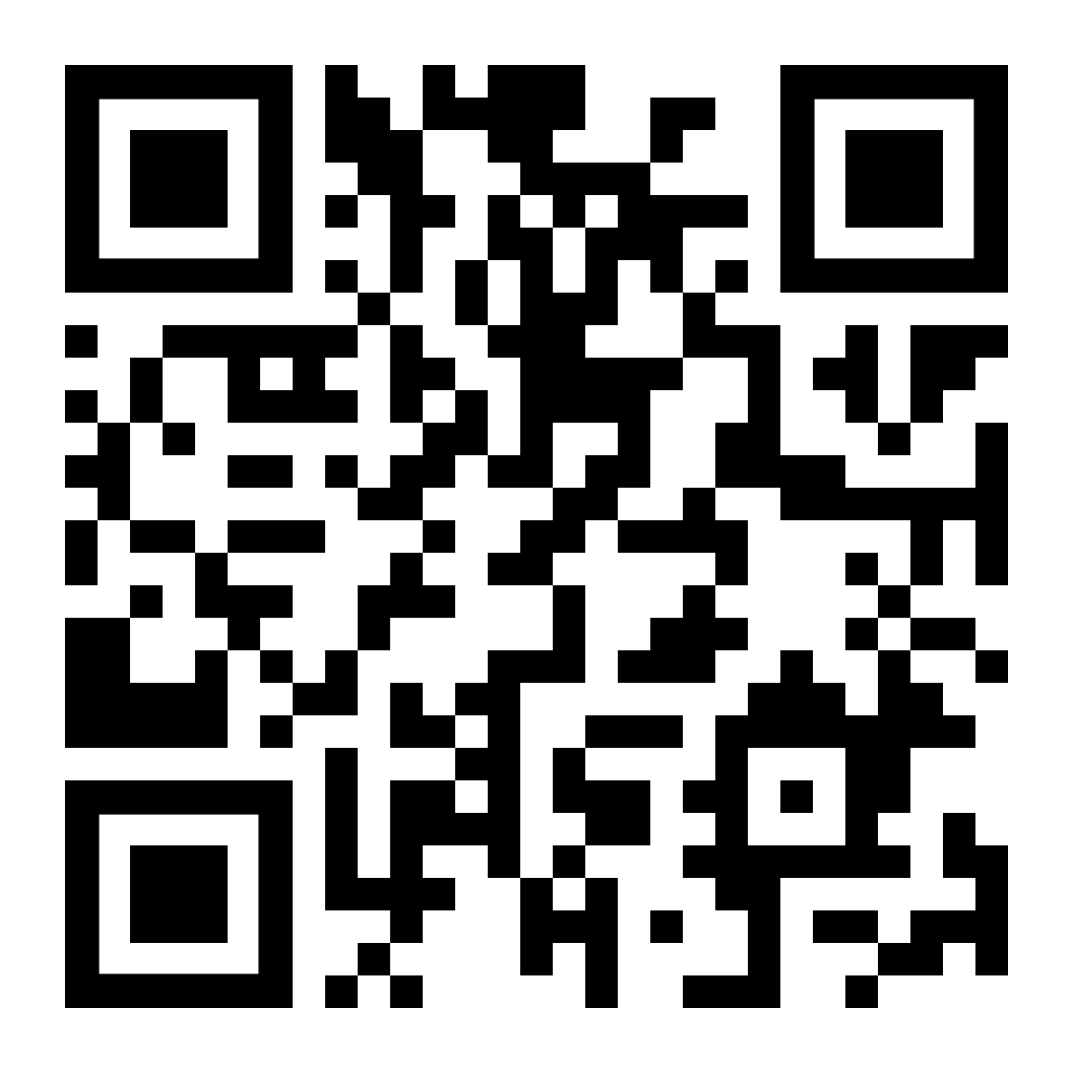
Did You Previously Learn about Design by Contract?

Slide 4
File Terminology
Given the file “/usr/bin/ls”
“ls” is called the base name
“/usr/bin” is called the dir(ectory) name
“/usr/bin/ls” is called the full name

Slide 5
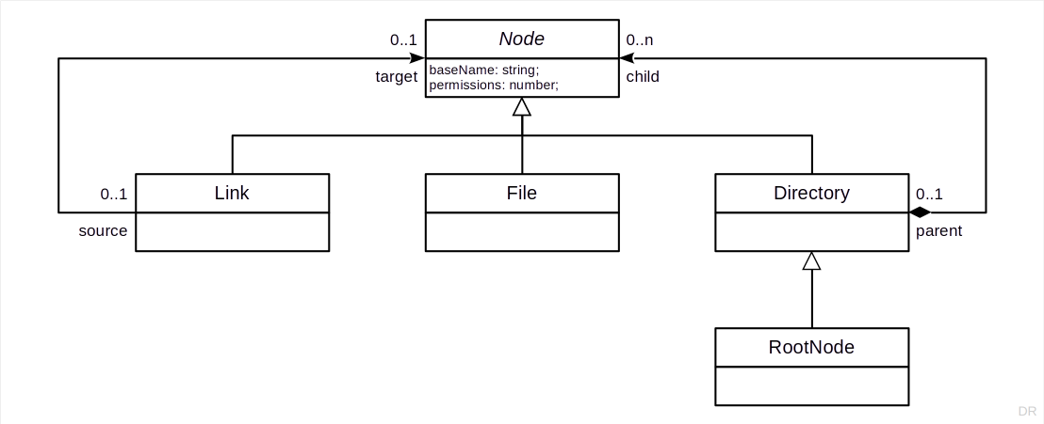
Extended Example

Slide 6
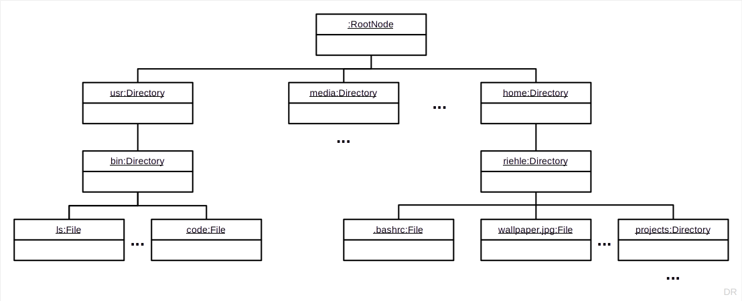
Quiz: Find “/usr/bin/ls”

Slide 7
1. Design by Contract

Slide 8
Design by Contract [M91]
Design by contract views
Software design as a succession of contracting decisions
[M91] Meyer, B. (1991). Design by Contract. Chapter 1 in Mandrioli, D., Meyer, B. (1991). Advances in Object-oriented Software Engineering. Prentice-Hall.

Slide 9
Contracts
A contract specifies rights (benefits) and obligations
Between a client (consumer) and contractor (supplier)
Contracts are (ideally) exhaustive; there are no hidden clauses
Rights and obligations are mutual
A client obligation (precondition) is contractor’s right
A contractor obligation (postcondition) is a client’s right
A contract protects both sides of the deal
The client is guaranteed a result
The contractor is guaranteed a specified operating environment

Slide 10
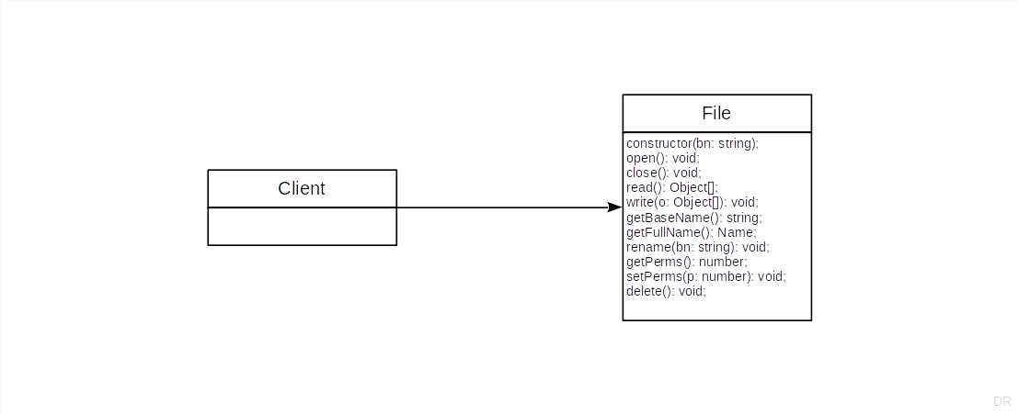
Client-File Contract 1 / 2

Slide 11
Client-File Contract 2 / 2
 | Rights | Obligations
Client | See contractor obligations | Provide valid base name Don’t open an open file Don’t open a deleted file Don’t close a closed file Don’t close a deleted file Don’t read from a closed file Don’t read from a deleted file Don’t write to a closed file …
Contractor | See client obligations | Perform functions properly
Where do you check that the obligations are met?

Slide 12
Defensive Programming
Defensive programming
Wikipedia: “[...] the programmer never assumes a particular function call or library will work as advertised”
Meyer: “[...] protect every software module by as many checks as possible, even those which are redundant with checks made by the clients.”
Problems with defensive programming
Multiplies the amount of checking code
Leads to bloated, hard-to-read, slow code
Redundant code is (mostly) a bad idea

Slide 13
Benefits of Design by Contract
Leads to well-specified interfaces
Leads to clean separation of work
Makes software more reliable

Slide 14
2. Expressing Contracts

Slide 15
Expressing Contracts
Preconditions
Postconditions
Class invariants

Slide 16
1. Preconditions
A precondition is
A boolean condition to be met for successful method entry
The purpose is to guarantee a safe operating environment
If violated, the method should not be executed
The client must make sure preconditions are met
A violation in the preconditions indicates a bug in the client
Preconditions are method-level components of a contract

Slide 17
Precondition Example
import { InvalidStateException } from "./InvalidStateException";
import { Node } from "./Node";
enum FileState { OPEN, CLOSED, DELETED };
export class File extends Node {
protected state: FileState = FileState.CLOSED;
public open(): void {
this.assertIsInState(FileState.CLOSED);
// ...
}
protected doGetState(): FileState {
return this.state;
}
protected assertIsInState(state: FileState) {
if (state != this.doGetState()) {
throw new InvalidStateException("invalid file state");
}
}
}

Slide 18
2. Postconditions
A postcondition is
A boolean condition guaranteed after successful method exit
The method must make sure postconditions are met
A violation of a postcondition indicates a bug in the method
Postconditions are method-level components of a contract

Slide 19
Postcondition Example
public open(): void {
this.assertIsInState(FileState.CLOSED);
// do something
this.assertIsInState(FileState.OPEN);
}
protected assertIsInState(state: FileState) {
if (state != this.doGetState()) {
throw new InvalidStateException("invalid file state");
}
}

Slide 20
3. Class Invariants
A class invariant is
A boolean condition that is true for any valid object
Permanent violation of the class invariant indicates a broken object
Temporary violation is possible during method execution
Class invariants are constraints on the object’s state space
The class (implementation) must make sure its invariants are maintained
Class invariants are class-level components of a contract

Slide 21
Class Invariants Example
export class Node {
protected baseName: string = "";
protected permissions: number = 0;
protected assertClassInvariants() {
this.assertHasValidBaseName();
this.assertHasValidPermissions();
}
...
}
export class File extends Node {
protected state: FileState = FileState.CLOSED;
protected assertClassInvariants() {
super.assertClassInvariants();
this.assertHasValidFileState();
}
...
}

Slide 22
3. Implementing Contracts

Slide 23
Defining Contracts
Where to define a contract?
Class invariants in (class) interface
Pre- and postconditions in public methods
But not for protected / private methods
How to define?
Using comments (documentation)
Using class or method annotations
Using asserts or assertion methods
Contracts are part of the public interface

Slide 24
Using Assertion Methods
Wrap assertions in assertion methods; they should be
Side-effect free (no call to any mutation method)
Throw an assertion-specific exception upon failure
Assertions can be programmed like any other method
Reuse assertion code by parameterization
Group assertions into larger assertion methods
Inherit assertion methods along the class hierarchy

Slide 25
Implementing Preconditions With Assertion Methods
Preconditions guard the entry to a public client-facing method
Call the corresponding assertion methods before the main method code
Precondition assertion methods are a form of before method
Failing a precondition must leave the object in a valid state
Because no mutation methods have been run yet
The exception signals the client is at fault

Slide 26
Implementing Postconditions With Assertion Methods
Postconditions ensure valid exit of a public client-facing method
Call the corresponding assertion methods after the main method code
Postcondition assertion methods are a form of after method
Failing the postcondition implies the service couldn’t be performed
The method should return the object to its method-entry state
The exception signals contractor failure

Slide 27
Implementing Class Invariants With Assertion Methods
Class invariants ensure that the object is in a valid state
Express the valid state space as a set of assertions
Group all assertions into one assertion methods
Failing the class invariant implies the object is in an invalid state
The how and why is probably unclear

Slide 28
Public Interface vs. Protected / Private Implementation
The contract only applies to the public interface
All assertions are run before and after any implementation code
While inside the object’s code, the public contract does not apply
You can still use assertion methods for other purposes

Slide 29
4. Contract Violations

Slide 30
Contract Violations
Precondition failure
The client did not fulfill the contract
Postcondition failure
The contractor could not provide the service
Class invariants
Something is wrong, really wrong

Slide 31
Recovery From Assertion Failure
Precondition failure
Nothing to recover from; object remained in valid state
Postcondition failure
Called method needs to return to initial valid state
Class invariant failure
Onus is on client; needs to reset the object to a valid state

Slide 32
Basic Exceptions to Use [1]
Precondition
IllegalArgumentException
Postcondition
MethodFailureException
Class invariants
InvalidStateException
[1] Javascript’s “Error” classes are a misnomer; exceptions are not errors

Slide 33
Contracts and Control Flow
Contractor
Use regular control flow (return) if nothing went wrong
Use exception to indicate contract violation
Client
Continue in regular control flow if nothing went wrong
Either resume operations or escalate exception
More on this in lecture on error and exception handling

Slide 34
5. Contract Pragmatics

Slide 35
Contract Pragmatics
Focus on preconditions to guard execution

Slide 36
Contracts and Subtyping
Subclass methods may have less requirements (weaken preconditions)
Example: Contravariant redefinition of argument types
Subclass methods may guarantee more (strengthen postconditions)
Example: Covariant redefinition of return types

Slide 37
Homework

Slide 38
Homework Instructions
Identify the names contracts from lecture and documentation
Implement preconditions, postconditions, and class invariants
Create corresponding component tests for the contract
Identify the files contracts from lecture and documentation
Implement the corresponding preconditions
Use the exception classes from common as explained in class
Adapt your previous work to this homework as you see fit
Commit homework by deadline to homework folder

Slide 39
Summary
Design by contract
Expressing contracts
Implementing contracts
Contract violations
Contract pragmatics

Slide 40
Thank you! Any questions?
dirk.riehle@fau.de – https://oss.cs.fau.de
dirk@riehle.org – https://dirkriehle.com – @dirkriehle

Slide 41
Legal Notices
License
Licensed under the CC BY 4.0 International license
Copyright
© 2012, 2018, 2024 Dirk Riehle, some rights reserved

